Slide 1
NLUCommandAdapter atau Remote Interpreter untuk RASA framework
atjahyanto@gmail.com

Slide 2
NLUCommandAdapter atau Remote Interpreter
Cara agar RASA tidak perlu menjalankan NLU sendiri, melainkan meneruskan teks user ke sebuah server NLU eksternal lewat HTTP.
Menggunakan model NLU sendiri (misalnya BERT fine-tuned, spaCy, GPT, dsb).
RASA hanya mengurus dialog management (Core), sedangkan interpretasi intent dan entity dilakukan di server terpisah.
RASA
API Service
Intent & Entity Recog
user
input
req

Slide 3
Cara kerja NLUCommandAdapter atau Remote Interpreter
User mengirim pesan: “my email is john@gmail.com".
RASA Core menerima pesan itu.
RASA meneruskan teks ke Remote NLU server (endpoint REST API).
Remote server memproses teks (misalnya pakai BERT classifier).
Remote server mengembalikan JSON dengan format:
{
"entities": [
{
"type": "EMAIL",
"word": "john@gmail.com"
}
],
"intent": {
"confidence": 0.2590380012989044,
"name": "affirm"
},
"text": "my email is john@gmail.com"
}

Slide 4
Skenario
Fine Tuning
dataset
model
"my_intent_model"
RASA
API Service
Intent & Entity Recog
user
input
req
Intent & entity
{
"entities": [
{
"type": "EMAIL",
"word": "john@gmail.com"
}
],
"intent": {
"confidence": 0.2590380012989044,
"name": "affirm"
},
"text": "my email is john@gmail.com"
}
"my email is john@gmail.com"

Slide 5
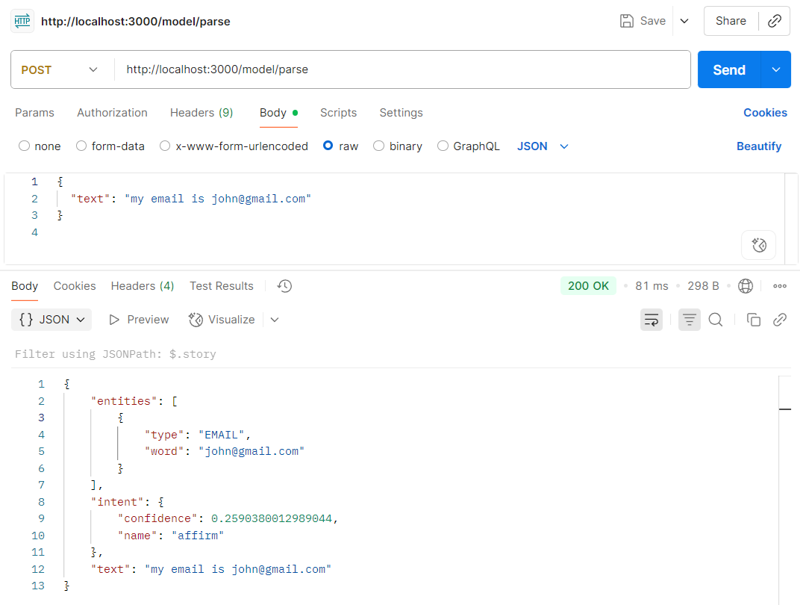
Testing dengan Postman
POST
Route/address
Body
Raw
Text
Send
myInterpreter.py
@app.route("/model/parse", methods=["POST"])
def parse():
data = request.get_json()
user_input = data.get("text", "")
// …

Slide 6
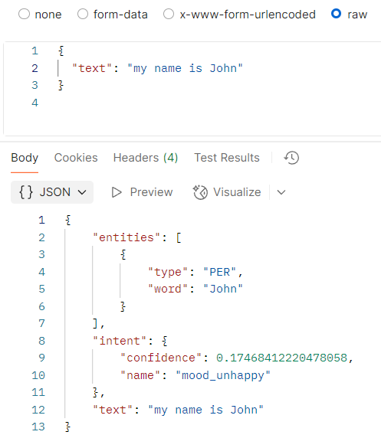
Testing dengan Postman

Slide 7
Konfigurasi pada config.yml
version: "3.1"
language: "en"
# -------------------------
# NLU Pipeline
# -------------------------
pipeline:
- name: NLUCommandAdapter # adapter ditambahkan di sini
url: "http://localhost:3000"
# -------------------------
# Dialogue Policies
# -------------------------
policies:
- name: MemoizationPolicy # mengingat persis dari stories
max_history: 5
- name: RulePolicy # untuk aturan fix (greet, fallback)
core_fallback_threshold: 0.3
core_fallback_action_name: "action_default_fallback"
enable_fallback_prediction: true
- name: TEDPolicy # ML policy utama untuk belajar dari stories.yml
max_history: 5
epochs: 100
constrain_similarities: true
assistant_id: 20250924-045037-leather-model
config.yml

Slide 8
Konfigurasi pada endpoints.yml
action_endpoint:
actions_module: "actions"
# Allow rephrasing of responses using a Rasa-hosted model
nlg:
type: rephrase
llm:
model_group: rasa_command_generation_model
model_groups:
- id: rasa_command_generation_model
models:
- provider: rasa
model: rasa/command-generator-llama-3.1-8b-instruct
api_base: "https://tutorial-llm.rasa.ai"
nlu:
url: "http://localhost:3000" # alamat server NLU
endpoints.yml

Slide 9
NLUCommandAdapter
Sebuah adapter/komponen khusus di RASA yang berfungsi sebagai jembatan (bridge) agar RASA bisa menggunakan service atau perintah NLU eksternal (biasanya lewat command line atau HTTP request).
Menyambungkan RASA ke NLU custom (misalnya skrip Python atau API model BERT).
Menjalankan perintah eksternal (command) setiap kali ada input user yang perlu diparse.
Mengubah hasil parsing dari format eksternal → ke format standar RASA (intent, confidence, entities).

Slide 10
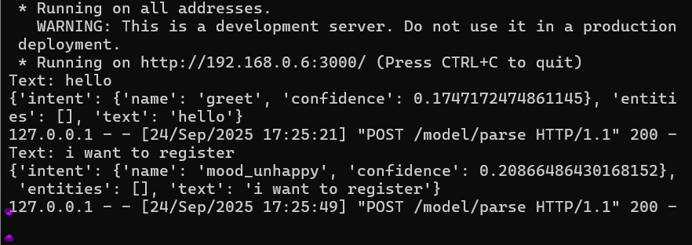
Contoh NLUCommandAdapter
myInterpreter.py
from flask import Flask, request, jsonify
from transformers import pipeline
import re
app = Flask(__name__)
ner_pipeline = pipeline("ner", model="dslim/bert-base-NER", aggregation_strategy="simple")
def hybrid_entity_recognition(text):
# 1. BERT-based NER
bert_entities = ner_pipeline(text)
# Standardisasi key dari BERT ke format seragam
standardized_bert_entities = [
{
"entity": ent["entity_group"],
"word": ent["word"],
"score": ent["score"],
"start": ent["start"],
"end": ent["end"],
}
for ent in bert_entities
]
# 2. Regex-based NER
regex_patterns = {
"EMAIL": r"[a-zA-Z0-9._%+-]+@[a-zA-Z0-9.-]+\.[a-zA-Z]{2,}",
"PHONE": r"\+?\d{1,3}[-\s]?\d{3}[-\s]?\d{3}[-\s]?\d{4}",
"DATE": r"\b\d{1,2}[/-]\d{1,2}[/-]\d{2,4}\b",
"URL": r"https?://[^\s]+",
}
regex_entities = []
for label, pattern in regex_patterns.items():
for match in re.finditer(pattern, text):
regex_entities.append({
"entity": label,
"word": match.group(),
"score": 1.0, # Regex tidak pakai probabilitas
"start": match.start(),
"end": match.end(),
})
# 3. Gabungkan hasil BERT + Regex
all_entities = standardized_bert_entities + regex_entities
return all_entities
#============================================
from transformers import BertTokenizer, BertForSequenceClassification
import torch
import pickle
def load_intent_model(model_path="my_intent_model"):
"""Load model, tokenizer, dan label encoder."""
model = BertForSequenceClassification.from_pretrained(model_path)
tokenizer = BertTokenizer.from_pretrained(model_path)
with open(f"{model_path}/label_encoder.pkl", "rb") as f:
label_encoder = pickle.load(f)
model.eval()
return model, tokenizer, label_encoder
def get_intent(text, model, tokenizer, label_encoder, entity_list):
"""Prediksi intent dari input text."""
inputs = tokenizer(text, return_tensors="pt", truncation=True, padding=True)
with torch.no_grad():
outputs = model(**inputs)
probs = torch.nn.functional.softmax(outputs.logits, dim=-1)
pred_idx = torch.argmax(probs, dim=1).item()
intent_name = label_encoder.inverse_transform([pred_idx])[0]
confidence = probs[0][pred_idx].item()
return {
"intent": {
"name": intent_name,
"confidence": float(confidence)
},
"entities": entity_list,
"text": text
}
model, tokenizer, label_encoder = load_intent_model("my_intent_model")
def get_intent_and_entity(text):
entities = hybrid_entity_recognition(text)
entity_list = []
for ent in entities:
my_entity = {'word': ent['word'], 'type': ent['entity']}
entity_list.append(my_entity)
#print(f"{ent['word']:<30} --> {ent['entity']} (start={ent['start']}, end={ent['end']})")
hasil = get_intent(text, model, tokenizer, label_encoder, entity_list)
return hasil
@app.route("/model/parse", methods=["POST"])
def parse():
data = request.get_json()
user_input = data.get("text", "")
print(f"Text: {user_input}")
# Return RASA-style response
response = get_intent_and_entity(user_input)
print (response)
return jsonify(response)
if __name__ == "__main__":
app.run(host="0.0.0.0", port=3000)
Jalankan:
Test dengan postman
python myInterpreter.py
Intent recognition
Entity recognition
def load_intent_model(model_path="my_intent_model"):
// …

Slide 11
Contoh proses fine-tuning model untuk NLUCommandAdapter
import torch
import pandas as pd
import numpy as np
import torch.nn as nn
from torch.utils.data import DataLoader, Dataset
from transformers import BertTokenizer, BertForSequenceClassification
from sklearn.model_selection import train_test_split
from sklearn.preprocessing import LabelEncoder
from sklearn.metrics import accuracy_score, classification_report
import matplotlib.pyplot as plt
bertModel = 'bert-base-uncased'
# Load the dataset
# ====== Dataset ======
data = {
"text": [
# greet
"hey", "hello", "hi", "hello there", "good morning", "good evening",
"moin", "hey there", "let's go", "hey dude", "goodmorning",
"goodevening", "good afternoon",
# goodbye
"cu", "good by", "cee you later", "good night", "bye", "goodbye",
"have a nice day", "see you around", "bye bye", "see you later",
# affirm
"yes", "yeah", "indeed", "of course", "that sounds good", "correct",
# deny
"no", "not", "never", "I don't think so", "don't like that", "no way", "not really",
# mood_great
"perfect", "great", "amazing", "feeling like a king", "wonderful",
"I am feeling very good", "I am great", "I am amazing",
"I am going to save the world", "super stoked", "extremely good",
"so so perfect", "so good", "so perfect",
# mood_unhappy
"my day was horrible", "I am sad", "I don't feel very well", "I am disappointed",
"super sad", "I'm so sad", "sad", "very sad", "unhappy", "not good",
"not very good", "extremly sad", "so saad", "so sad",
# bot_challenge
"are you a bot?", "are you a human?", "am I talking to a bot?", "am I talking to a human?",
# provide_name
"My name is Ali", "I am John", "It's Sarah", "My name Budi",
# provide_email
"My email is ali@example.com", "My email is budi@example.com", "You can reach me at john@mail.com",
# user_regist
"I want to register", "Registration please", "I am a new user",
# show_info
"Show me my registration", "What did I give?", "Review my data"
],
"label": [
# greet
"greet","greet","greet","greet","greet","greet","greet","greet","greet","greet","greet","greet","greet",
# goodbye
"goodbye","goodbye","goodbye","goodbye","goodbye","goodbye","goodbye","goodbye","goodbye","goodbye",
# affirm
"affirm","affirm","affirm","affirm","affirm","affirm",
# deny
"deny","deny","deny","deny","deny","deny","deny",
# mood_great
"mood_great","mood_great","mood_great","mood_great","mood_great",
"mood_great","mood_great","mood_great","mood_great","mood_great",
"mood_great","mood_great","mood_great","mood_great",
# mood_unhappy
"mood_unhappy","mood_unhappy","mood_unhappy","mood_unhappy","mood_unhappy",
"mood_unhappy","mood_unhappy","mood_unhappy","mood_unhappy","mood_unhappy",
"mood_unhappy","mood_unhappy","mood_unhappy","mood_unhappy",
# bot_challenge
"bot_challenge","bot_challenge","bot_challenge","bot_challenge",
# provide_name
"provide_name","provide_name","provide_name","provide_name",
# provide_email
"provide_email","provide_email","provide_email",
# user_regist
"user_regist","user_regist","user_regist",
# show_info
"show_info","show_info","show_info"
]
}
df = pd.DataFrame(data)
texts = list(df["text"])
labels = df["label"].values
categories = np.unique(labels)
sample_size = len(texts)
num_class = len(categories)
# Encode labels
label_encoder = LabelEncoder()
encoded_labels = label_encoder.fit_transform(labels)
# Split the dataset into train and test sets
X_train, X_test, y_train, y_test = train_test_split(texts, encoded_labels, test_size=0.3, random_state=42)
# Tokenizer and Dataset Class
tokenizer = BertTokenizer.from_pretrained(bertModel)
class myDataset(Dataset):
def __init__(self, texts, labels, tokenizer, max_len=512):
self.texts = texts
self.labels = labels
self.tokenizer = tokenizer
self.max_len = max_len
def __len__(self):
return len(self.texts)
def __getitem__(self, idx):
text = self.texts[idx]
label = self.labels[idx]
encoding = self.tokenizer.encode_plus(
text,
add_special_tokens=True,
truncation=True,
max_length=self.max_len,
return_token_type_ids=False,
padding='max_length',
return_attention_mask=True,
return_tensors='pt'
)
return {
'input_ids': encoding['input_ids'].flatten(),
'attention_mask': encoding['attention_mask'].flatten(),
'label': torch.tensor(label, dtype=torch.long)
}
print ("Prepare the datasets")
# Prepare the datasets
train_dataset = myDataset(X_train, y_train, tokenizer)
test_dataset = myDataset(X_test, y_test, tokenizer)
# DataLoader
train_loader = DataLoader(train_dataset, batch_size=16, shuffle=True)
test_loader = DataLoader(test_dataset, batch_size=16)
print ("Load the BERT model")
# Load BERT model
model = BertForSequenceClassification.from_pretrained(bertModel, num_labels=num_class)
device = torch.device('cuda' if torch.cuda.is_available() else 'cpu')
model.to(device)
print ("Device yang dipakai: ", device)
# Optimizer and loss function
optimizer = torch.optim.Adam(model.parameters(), lr=2e-5)
loss_fn = nn.CrossEntropyLoss()
# save the model
def save_model(model, tokenizer, model_name = "my_intent_model"):
# ====== Save Model and Tokenizer ======
model.save_pretrained(model_name)
tokenizer.save_pretrained(model_name)
import pickle
with open(model_name+"/label_encoder.pkl", "wb") as f:
pickle.dump(label_encoder, f)
return
# Training loop
def train_model(model, train_loader, loss_fn, optimizer, device, epochs=10):
model.train()
train_losses = []
for epoch in range(epochs):
total_loss = 0
correct_predictions = 0
for batch in train_loader:
input_ids = batch['input_ids'].to(device)
attention_mask = batch['attention_mask'].to(device)
labels = batch['label'].to(device)
optimizer.zero_grad()
outputs = model(input_ids=input_ids, attention_mask=attention_mask)
loss = loss_fn(outputs.logits, labels)
total_loss += loss.item()
_, preds = torch.max(outputs.logits, dim=1)
correct_predictions += torch.sum(preds == labels)
loss.backward()
optimizer.step()
avg_loss = total_loss / len(train_loader)
accuracy = correct_predictions.double() / len(train_loader.dataset)
train_losses.append(avg_loss)
print(f'Epoch {epoch+1}/{epochs}, Loss: {avg_loss}, Accuracy: {accuracy:.4f}')
return train_losses
# Evaluation
def evaluate_model(model, test_loader, device):
model.eval()
all_preds = []
all_labels = []
with torch.no_grad():
for batch in test_loader:
input_ids = batch['input_ids'].to(device)
attention_mask = batch['attention_mask'].to(device)
labels = batch['label'].to(device)
outputs = model(input_ids=input_ids, attention_mask=attention_mask)
_, preds = torch.max(outputs.logits, dim=1)
all_preds.extend(preds.cpu().numpy())
all_labels.extend(labels.cpu().numpy())
print (all_labels)
print (all_preds)
print (type(all_labels))
print (type(all_preds))
accuracy = accuracy_score(all_labels, all_preds)
print(f'Accuracy: {accuracy:.4f}')
print(classification_report(all_labels, all_preds))
return accuracy
# Train the model
train_losses = train_model(model, train_loader, loss_fn, optimizer, device)
save_model(model, tokenizer)
# Evaluate the model
accuracy = evaluate_model(model, test_loader, device)
# Plot training loss
plt.plot(train_losses, label='Training loss')
plt.title('Training Loss over Epochs')
plt.xlabel('Epochs')
plt.ylabel('Loss')
plt.legend()
plt.show()
Modifikasi hyper-parameter yang digunakan agar kinerja lebih bagus
Epoch
Menambah dataset
dsb
def save_model(model, tokenizer, model_name = "my_intent_model"):
// …

